Slide 1
World’s best 10 computer builds
Senzo Masango
4471
SKS511
FA2

Slide 2
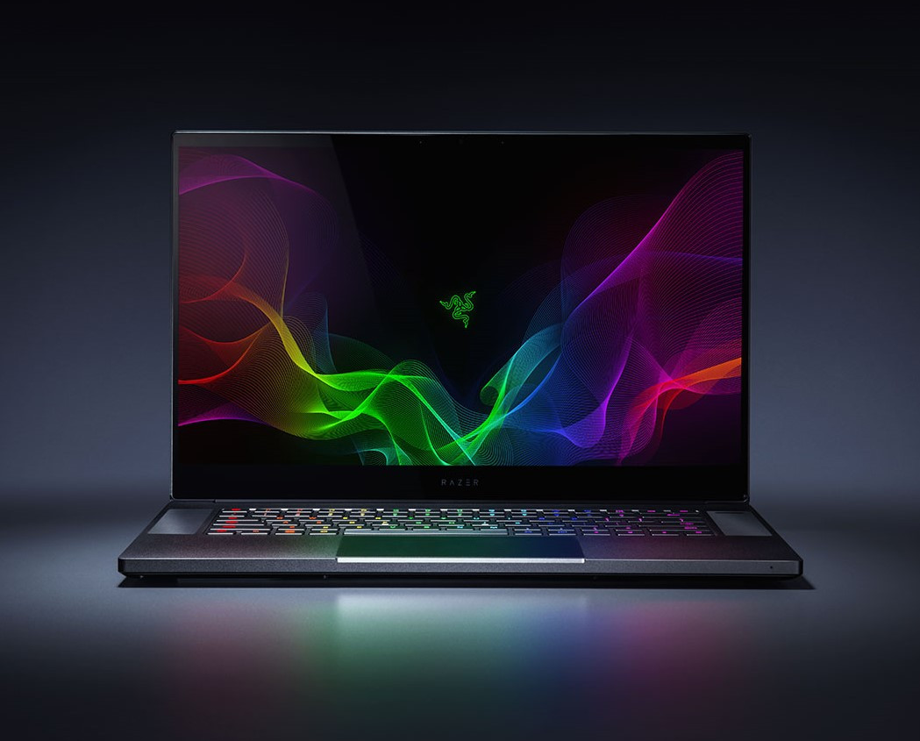
Manufacture:Razer Name:Razer blade www.razer.com
Operating System | Windows® 10 Home (64-bit)
Graphics | • GeForce RTX 2060 • GeForce RTX 2070 Max-Q • GeForce RTX 2080 Max-Q | • GeForce GTX 1060 Max-Q
15.6” Display | • Full HD 144Hz or 4K Touch* | • Full HD 60Hz
Storage | • Single Storage SSD | • Dual Storage SSD + HDD
Keyboard | • Per Key Chroma | • Single-zone Chroma
Gigabit Ethernet | • No | • Yes
Thinness | • 0.70” / 17.8mm | • 0.78” / 19.9mm

Slide 3
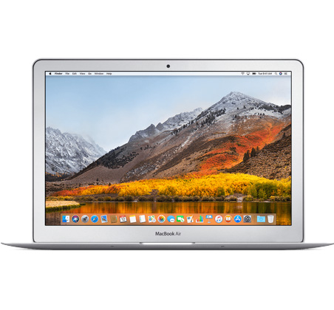
Manufacture: Apple Name:Mac book air www.apple.com
Display
13.3-inch (diagonal) LED-backlit glossy widescreen display with support for millions of colors
Supported resolutions: 1440 by 900 (native), 1280 by 800, 1152 by 720, and 1024 by 640 pixels at 16:10 aspect ratio and 1024 by 768 and 800 by 600 pixels at 4:3 aspect ratio
Storage1
128GB
128GB PCIe-based SSD
Configurable to 256GB or 512GB SSD
256GB
256GB PCIe-based SSD
Configurable to 512GB SSD
Processor
1.8GHz dual-core Intel Core i5, Turbo Boost up to 2.9GHz, with 3MB shared L3 cache
Configurable to 2.2GHz dual-core Intel Core i7, Turbo Boost up to 3.2GHz, with 4MB shared L3 cache
Memory
8GB of 1600MHz LPDDR3 onboard memory
Battery and Power2
Up to 12 hours wireless web
Up to 12 hours iTunes movie playback
Up to 30 days standby time
Built-in 54‑watt‑hour lithium‑polymer battery
45W MagSafe 2 Power Adapter with cable management; MagSafe 2 power port

Slide 4
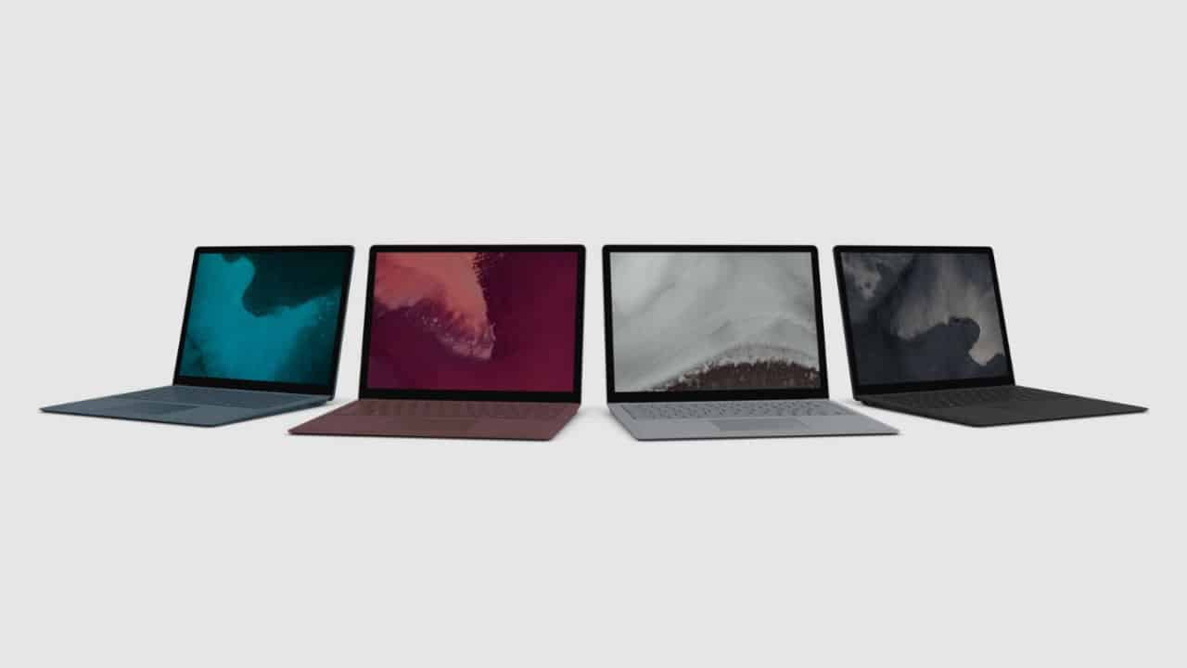
Manufacture: Microsoft Name: Microsoft surface laptop 2 www.cnet.com
Operating System
Windows 10 Home
Windows 10 Pro
Built-in Apps
Microsoft Office 365 30-days trial
Display
Display Size
13.5 inches
Display Resolution
2256 x 1504 (201 PPI), 3.4M Pixels
Screen Technology
PixelSense™ Display
Aspect ratio: 3:2
Inking: Supports Surface Pen
Touch: 10 points multi-touch
Corning® Gorilla® Glass 3
10nm Oleophobic Coating
100% sRGB color, individually calibrated
Internal Specs
CPU
8th Gen Intel® Core™ i5-8250U quad-core8th Gen Intel® Core™ i7-8650U quad-core
8th Gen Intel® Core™ i5-8350U quad-core8th Gen Intel® Core™ i7-8650U quad-core
Graphics
Intel® UHD Graphics 620
Memory
8 GB 16 GB 1866 MHz LPDDR3 RAM
Storage
128 GB256 GB512 GB1 TB SSD
Network
- Wi-Fi: IEEE 802.11 a/b/g/n/ac compatible
- Bluetooth Wireless 4.1 technology

Slide 5
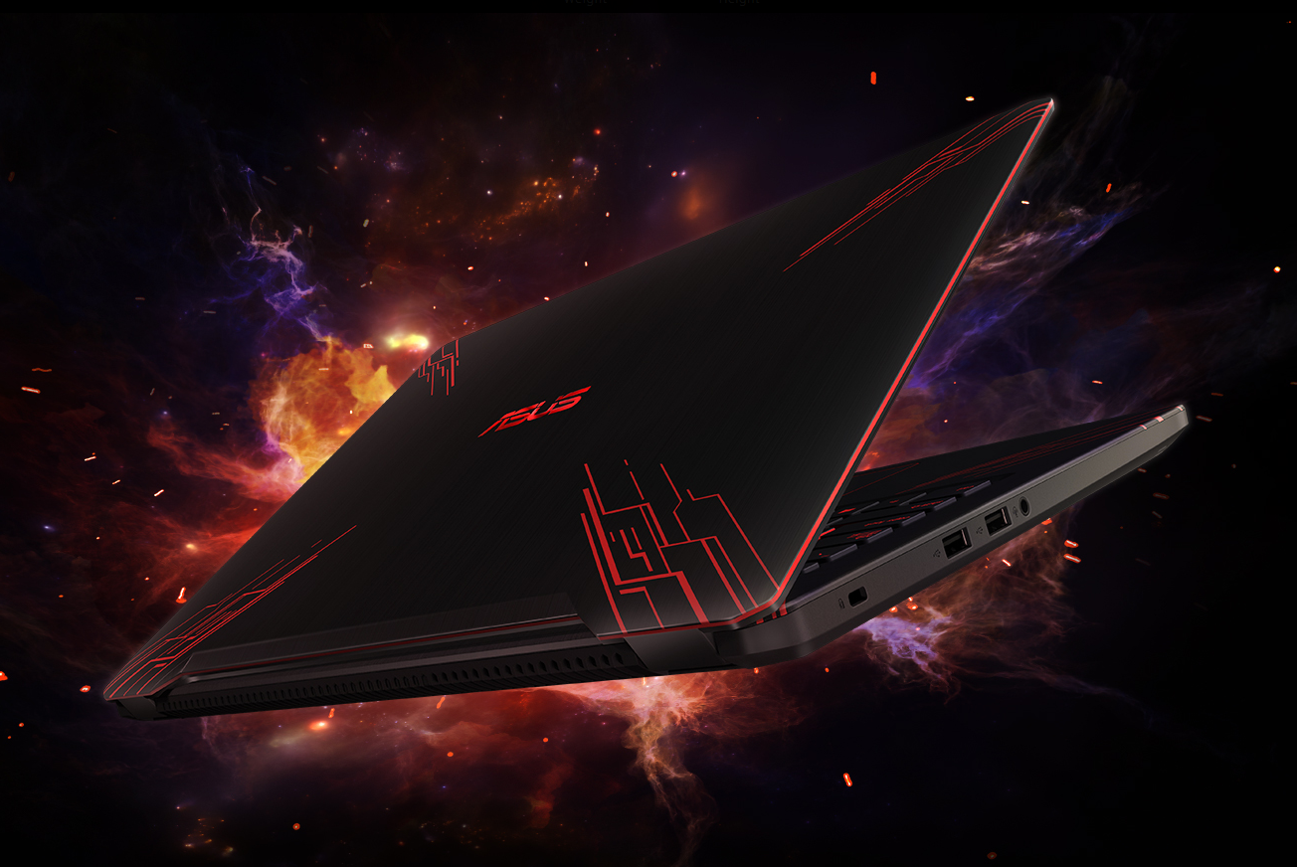
Manufacture: ASUS Name:FX 570 www.Asus.com
Processor
Intel Core i7-8550U (Intel Core i7)
Graphics adapter
NVIDIA GeForce GTX 1050 (Laptop)
Memory
16384 MB
Display
15.6 inch 16:9, 3840 x 2160 pixel 282 PPI, glossy: no
Storage
, GB
, 256 GB SSD + 500 GB HDD
Connections
4 USB 3.0 / 3.1 Gen1, 1 HDMI, Card Reader: undefined
Networking
802.11 a/b/g/n/ac (a/b/g/n/ac), Bluetooth 4.1
Size
height x width x depth (in mm): 22 x 374 x 256 ( = 0.87 x 14.72 x 10.08 in)
Battery
48 Wh
Operating System
Microsoft Windows 10 Home 64 Bit
Additional features
Keyboard Light: yes
Weight
1.9 kg ( = 67.02 oz / 4.19 pounds) ( = 0 oz / 0 pounds)

Slide 6
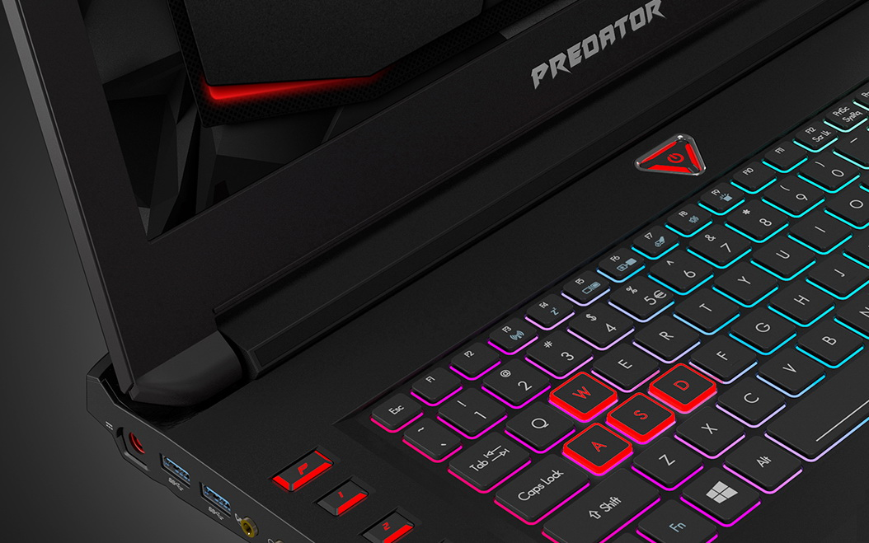
Manufacture: Acer Name:Predator 15 www.Acer.com
Processor / Chipset
CPU
Intel Core i7 (6th Gen) 6700HQ / 2.6 GHz
Max Turbo Speed
3.5 GHz
Number of Cores
Quad-Core
Cache
6 MB
64-bit Computing
Yes
Chipset Type
Mobile Intel HM175
Features
Hyper-Threading Technology, Intel Smart Cache, Intel Turbo Boost Technology 2.0
Cache Memory
Installed Size
6 MB
Storage
Interface
Serial ATA-600
Optical Drive
DVD±RW (±R DL) / DVD-RAM - tray
Memory
Max Supported Size
64 GB
Technology
DDR4 SDRAM
Form Factor
SO-DIMM 260-pin
Slots Qty
4
Empty Slots
2
RAM
Configuration Features
2 x 8 GB
Technology
DDR4 SDRAM
Installed Size
16 GB
Display
LCD Backlight Technology
LED backlight
Resolution
1920 x 1080 (Full HD)
Widescreen Display
Yes
Image Aspect Ratio
16:9
Monitor Features
anti-glare
Type
LED
TFT Technology
IPS
Diagonal Size (metric)
39.6 cm
Display Resolution Abbreviation
Full HD

Slide 7
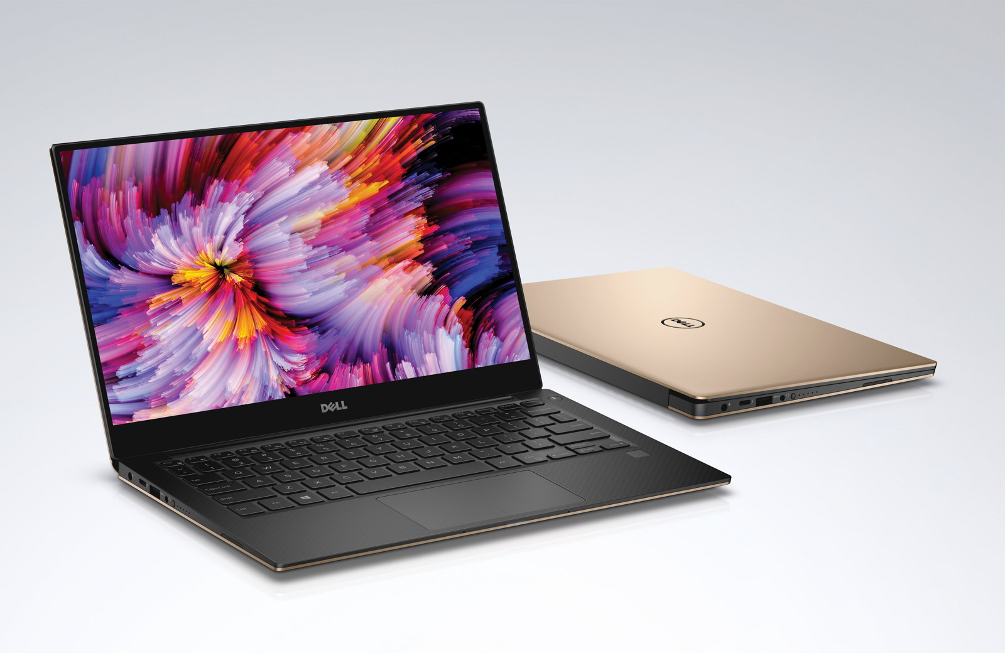
Manufacture: Dell, inc Name:XPS 13 www.gsmarena.com
RAM
Memory Speed
1333 MHz
Technology
DDR3 SDRAM
Installed Size
4 GB
Hard Drive
Capacity
256 GB
Processor
CPU Type
Core i7 2nd Generation
Processor Number
2637M
Manufacturer
Intel
Header
Compatibility
PC
System
Notebook Type
Ultrabook
Hard Drive Capacity
256 GB
Monitor
Diagonal Size
13.3
Operating System / Software
OS Provided: Type
Windows 7 Home Premium, 64bit, English
Video Output
Graphics Processor
Intel HD Graphics 3000

Slide 8
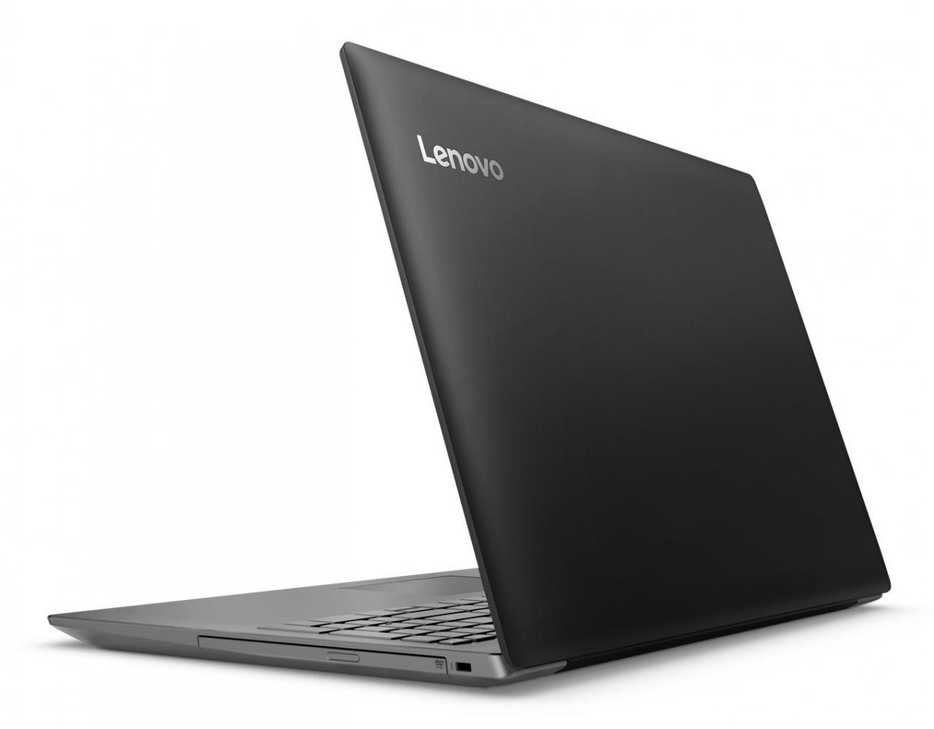
Manufacture: Lenovo Name: ideapad 320s www.gsmarena.com
Processor / Chipset
CPU
Intel Core i3 (7th Gen) 7100 / 2.4 GHz
Number of Cores
Dual-Core
Cache
3 MB
64-bit Computing
Yes
Features
integrated memory controller
Cache Memory
Installed Size
3 MB
Storage
Interface
Serial ATA-600
Optical Drive
DVD-Writer - tray
Memory
Max Supported Size
16 GB
Technology
DDR4 SDRAM
Speed
2133 MHz - 2133 MHz
Technology
DDR4 SDRAM
4 GB
Rated Memory Speed
2133 MHz
Display
LCD Backlight Technology
LED backlight
Resolution
1366 x 768 (HD)
Widescreen Display
Yes
Image Aspect Ratio
16:9
Monitor Features
anti-glare
Type
LED
TFT Technology
TN
Diagonal Size (metric)
39.6 cm
Display Resolution Abbreviation
HD
Audio & Video
Graphics Processor
Intel HD Graphics 620

Slide 9
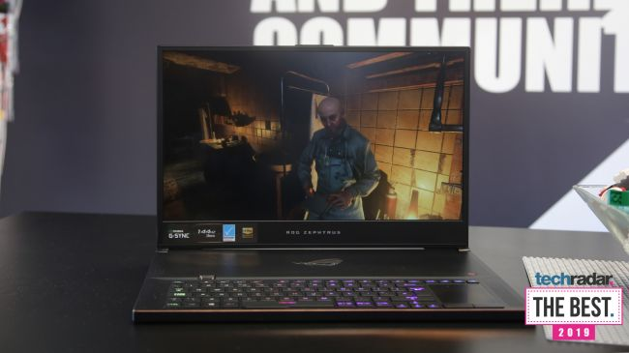
Manufacture: Asus Name: Asus ROG Zephyrus S GX701 www.techradar.com
CPU: Intel Core i7 | Graphics: Nvidia GeForce GTX 2080 MAX-Q (8GB GDDR6 VRAM) | RAM: 8-24GB | Screen: 17.3-inch FHD (1,920 x 1,080) 144Hz panel with G-Sync | Storage: 1TB M.2 PCIe x4 SSD

Slide 10
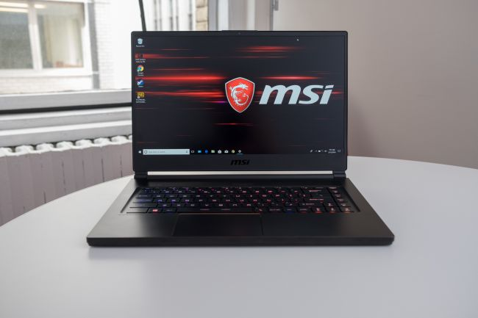
Manufacture: MSI Name: MSI GS65 Stealth www.techradar.com
CPU: Intel Core i7 | Graphics: Nvidia GeForce GTX 1070 (8GB GDDR5X VRAM, Max-Q) | RAM: 16GB | Screen: 15.6-inch FHD (1,920 x 1,080) anti-glare, wide-view 144Hz panel | Storage: 512GB M.2 SSD

